Slide 1
Adventures in Chess
Or: Why is the Pawn Still Broken

Slide 2
What is chess?
Simple (yet extraordinarily complex) two player board game
Objective: Capture the other players king
Board is an 8x8 grid
Six different types of pieces with their own move rules
Each player has:
8 Pawns 2 Horses 2 Rooks
2 Bishops 1 Queen 1 King
16 pieces

Slide 3
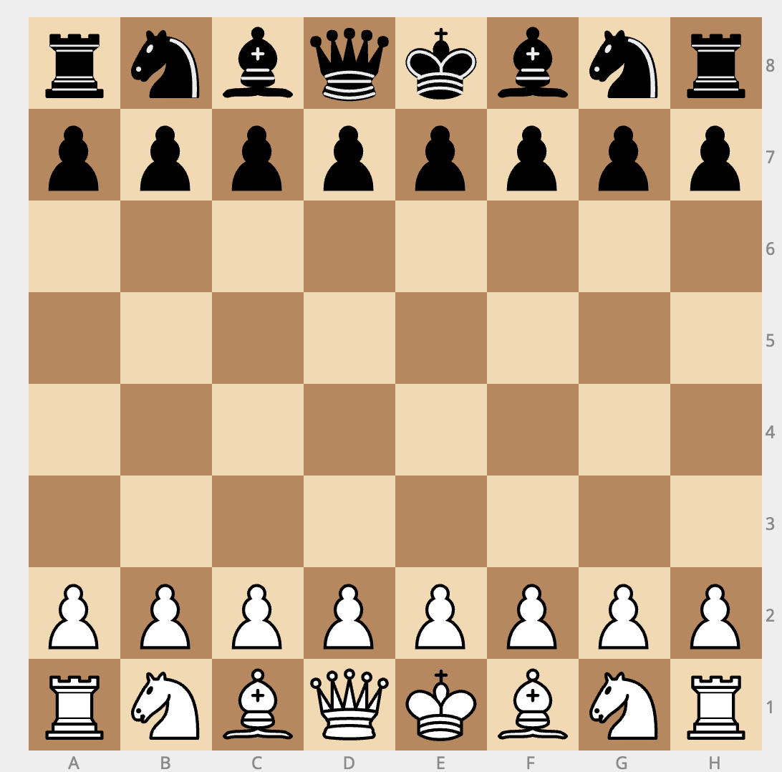
Chess Board
Kill this guy to win

Slide 4
Move Checks
Each piece must pass four move checks in order to move
Can the piece move in that way
Is there a piece in the way
Will it kill your piece
Will it leave your king in check
There are a two smaller check handled higher up
Is your input a position on the board
Do you have a piece at that position

Slide 5
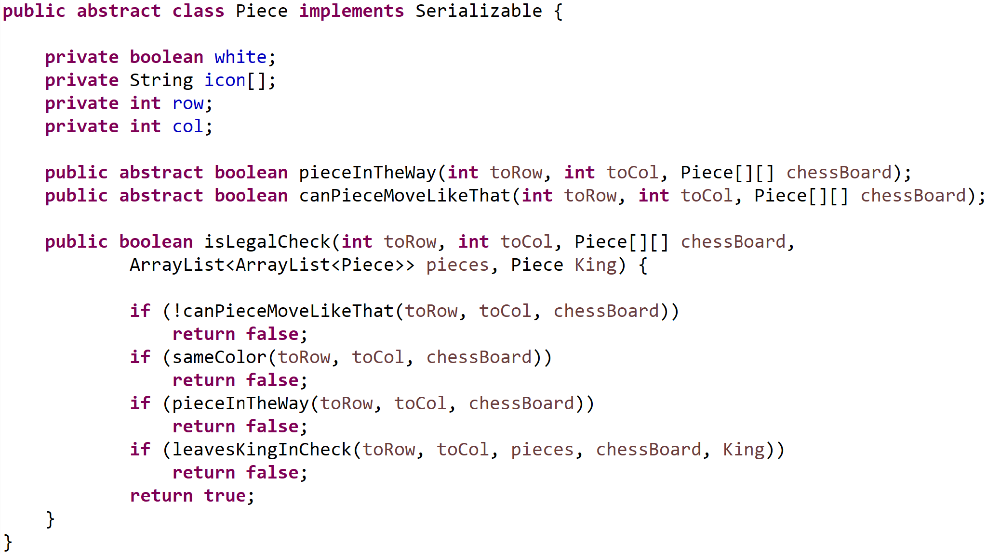
Move Checks
Each piece moves in a unique way
But all need to conform to two important checks
canPieceMoveLikeThat
pieceInTheWay
Use a Piece interface
We will focus on these two methods for now

Slide 6
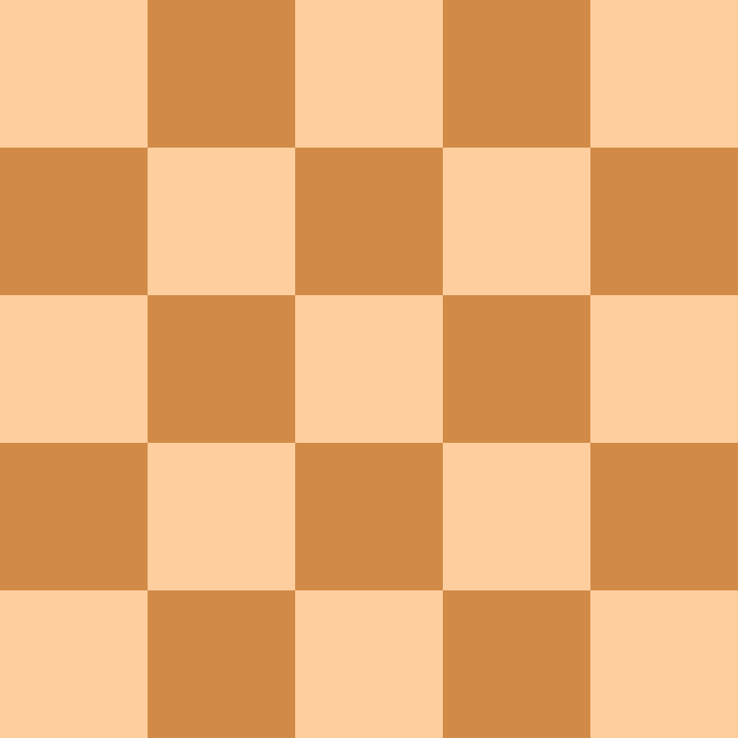

The Rook
Rooks can move in a single axis
Up – Down
Right – Left
It cannot pass over any pieces

Slide 7
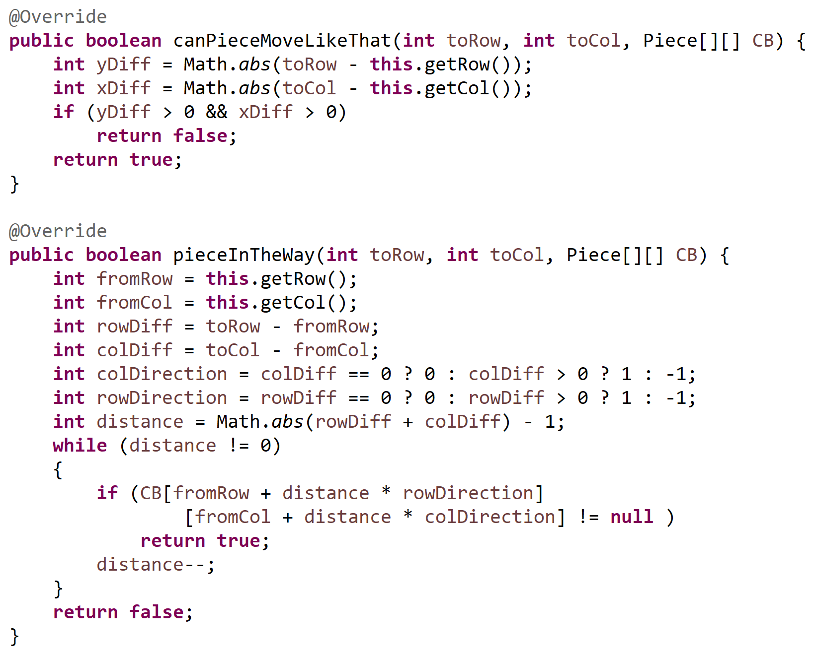
The Rook
canPieceMoveLikeThat
Check if only one axis is changed and the other remained at zero
pieceInTheWay
Theory is simple
Loop through axis and check if anything is in the way
Execution is a little more complex
We use some math tricks to get it down to a single while loop

Slide 8

The Bishop
Bishops can move equally in both axes
It’s essentially a rotated rook
Bottom Left – Top Right
Top Left – Bottom Right
It cannot pass over any pieces

Slide 9
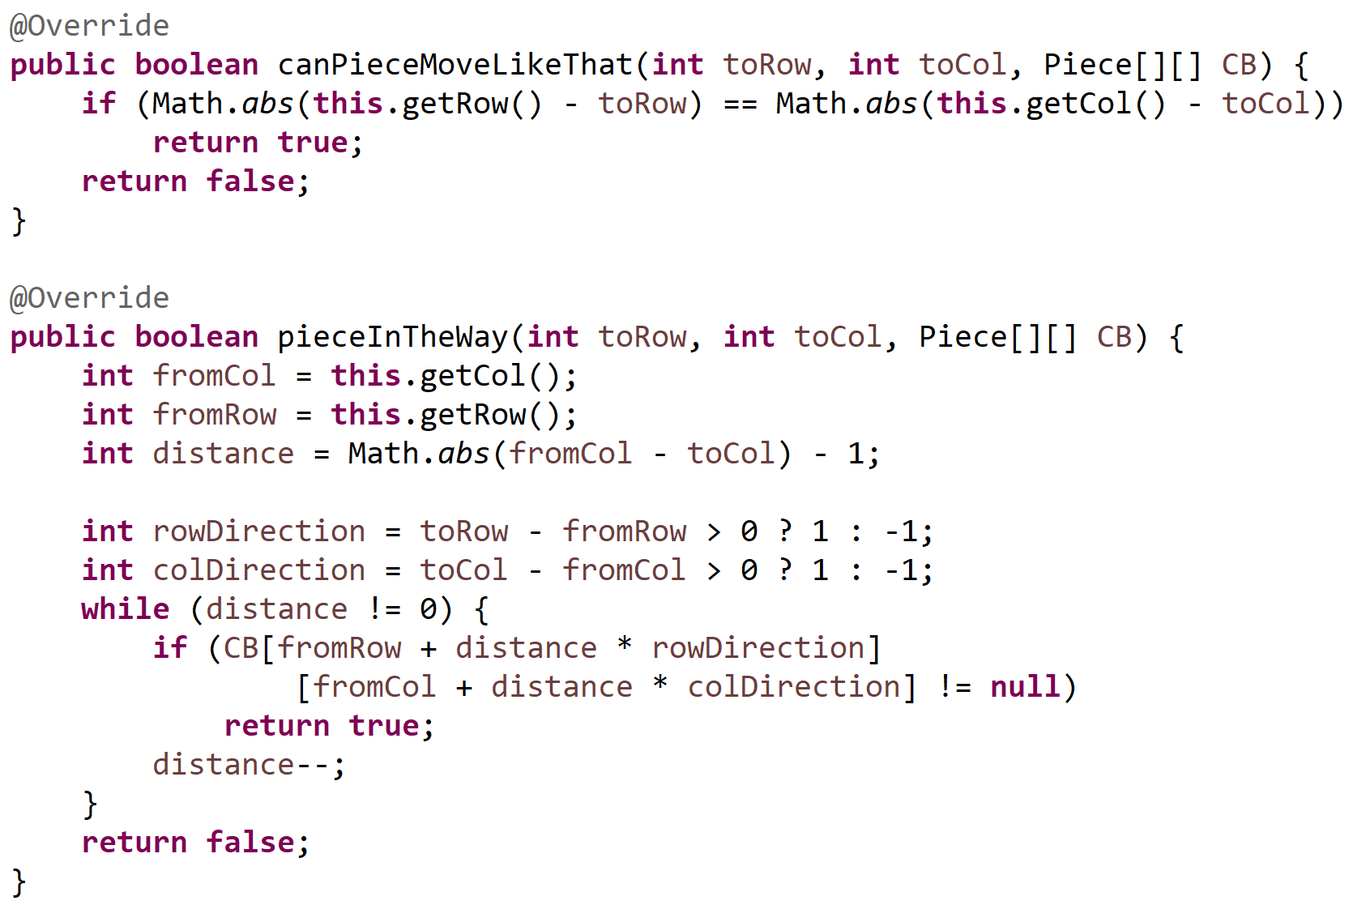
Rooks
canPieceMoveLikeThat
Check if the change in one axis is equal to the change in the other axis
pieceInTheWay
Theory is simple
Loop through both axes and check if anything is in the way
Execution is a little more complex
We use some math tricks to get it down to a single while loop

Slide 10

The queen
The queen can move in four axes
Up – Down
Left – Right
Bottom Left – Top Right
Top Left – Bottom Right
It’s a combination of a rook and bishop
It cannot jump over other pieces

Slide 11
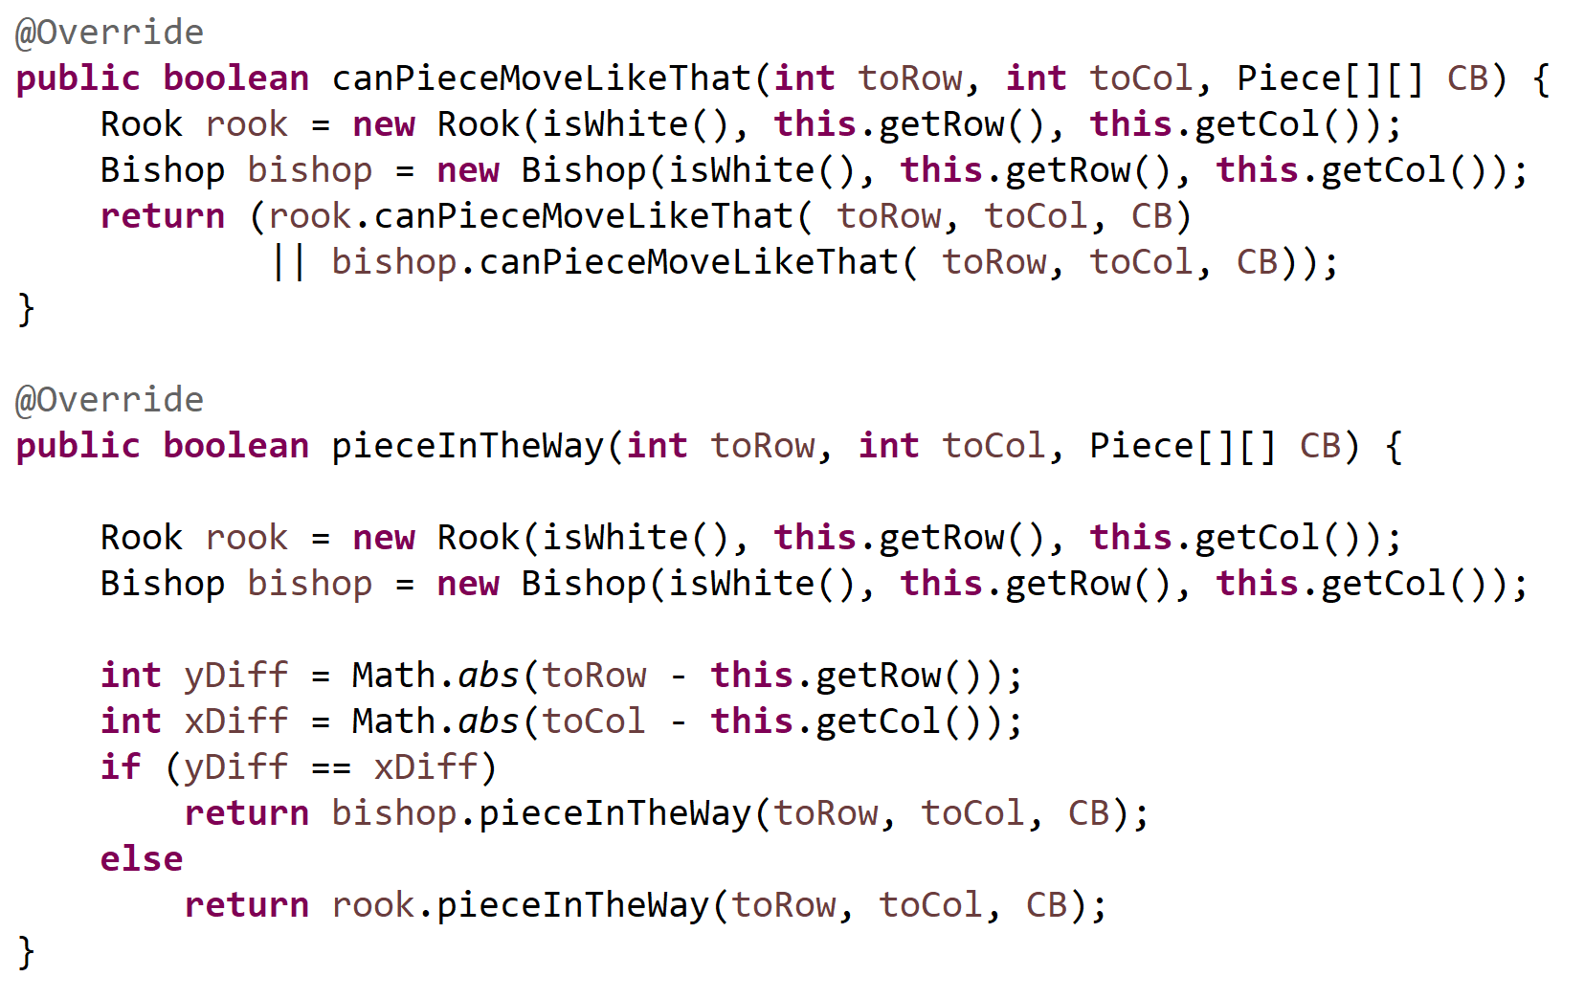
Her majesty
canPieceMoveLikeThat
Can a rook or a bishop move like that?
pieceInTheWay
Depending on how if it’s moving like a bishop or a rook, does it have pieces in the way?

Slide 12

The king
The king has the same move set as the queen, limited to a distance of one
Approaches:
Use a queen and limit it to a distance of one
Check if distance of both the row and column is less than two
Much easier to check the eight immediate spaces surrounding it

Slide 13
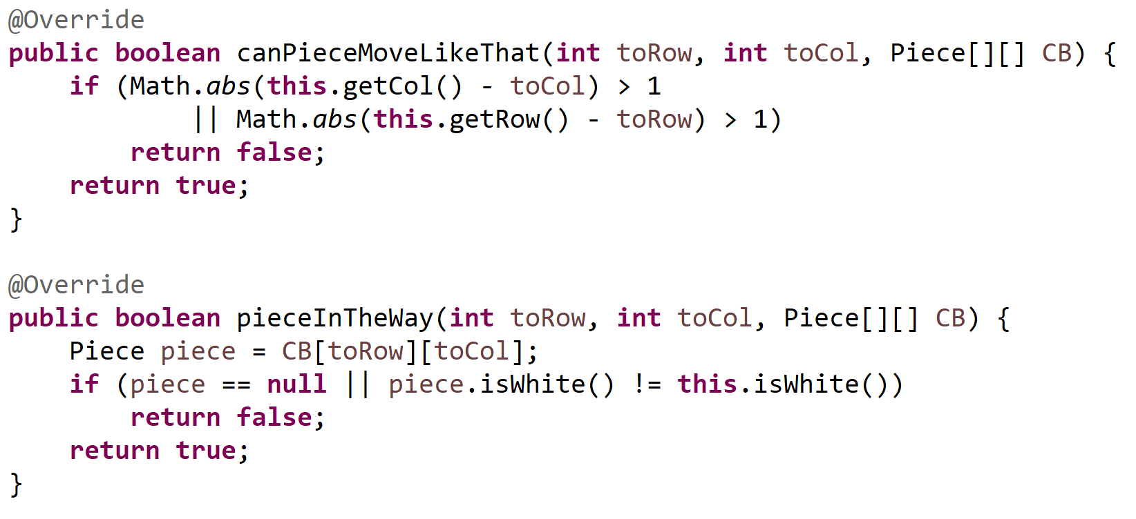
His highness
canPieceMoveLikeThat
Check if the move distance of the row and column is not more than one
pieceInTheWay
If there is no piece there it’s good
If there is, as long as it’s not the same color it’s still good

Slide 14


The horse
Horses have a very interesting move set
One approach is to figure out the weird logic behind it
The easier way is to realize that they are the anti-queen
Wherever a queen can go, they cannot

Slide 15
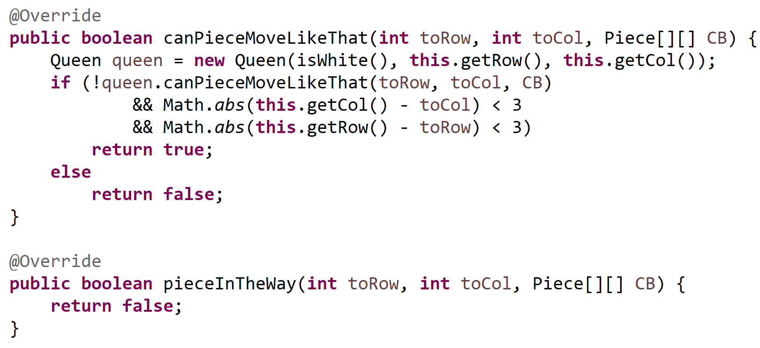
The horse
canPieceMoveLikeThat
1. Make sure a queen cannot move like that
2. Make sure both the column and row distance is less than three
pieceInTheWay
Always returns false because horses can jump

Slide 16


The Pawn
Pawns are weird
Only piece that has differing move rules depending on the circumstances
Normally moves one space forward
On the first move it can move two spaces forward
It can move one diagonal when killing a piece
It can sometimes move diagonal to a empty space if there is a pawn in front of that space

Slide 17
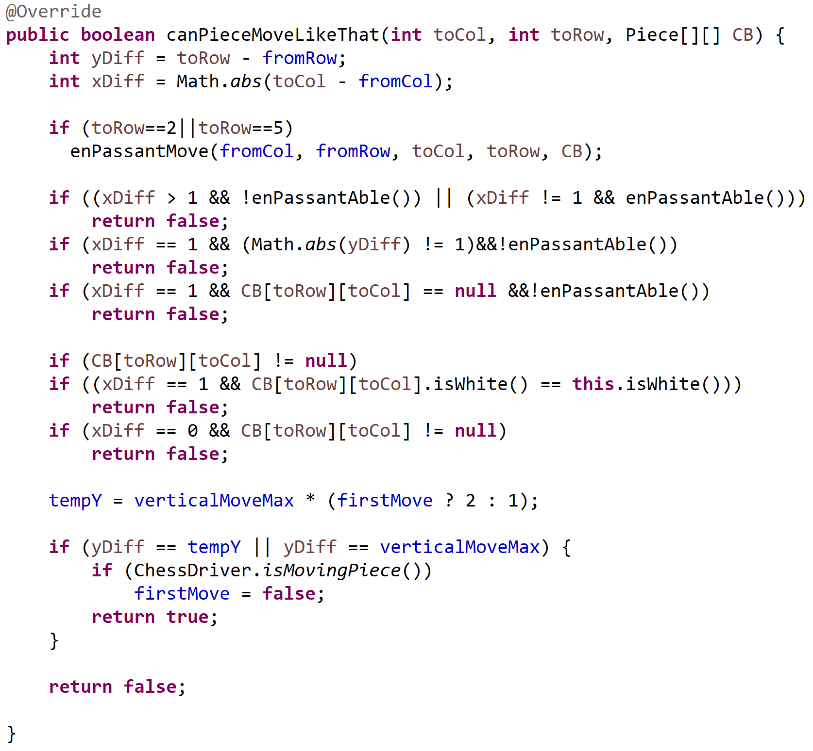
EVIL
First approach:
Code was nearly impossible to follow
Was the result of patches on top of patches
Something was ALWAYS not working correctly
Bugs that didn’t seem possible managed to suddenly exist
Time to change the approach

Slide 18
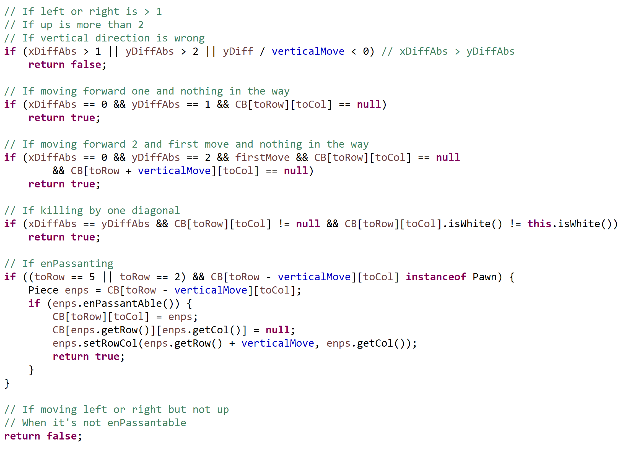

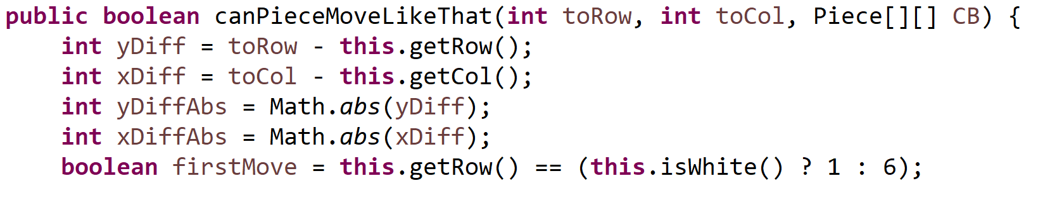
The pawn

Slide 19
The board
We have three different approaches to store the board
Array of pieces that hold their row and column
Pros: for inCheck just loop over and see if any pieces can kill the other king
Cons: Displaying the board and move checking requires you to loop over the array 64 times
Two arrays of pieces – one for white & one for black
Pros – Again, makes inCheck easier
Cons – Displaying the board requires an even bigger loop
2D Piece array
Pros: Makes display and move checking much simpler
Cons: O(n^2) for inCheck method – need to loop to find the king, then loop to find opposing pieces

Slide 20
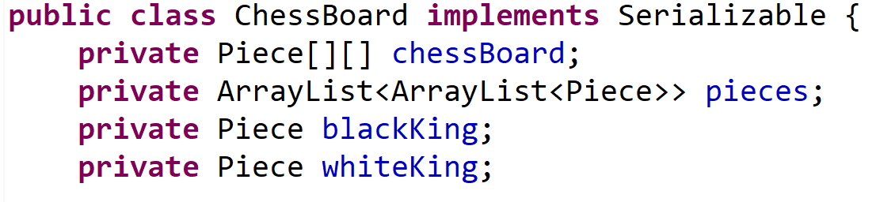
The board
Solution?
Use all three!
Originally all the board variables were kept in the main class
Now everything is handled in a ChessBoard class which holds all the pieces, arrays, variables, etc.

Slide 21
Board Set up
Regular game is hardcoded in
Random game has three steps:
Places a king somewhere in the starting area
Loops over started area and places a random piece
Loops over finished side and copies it for the other player
Loops over board and adds pieces to their respective ArrayList

Slide 22
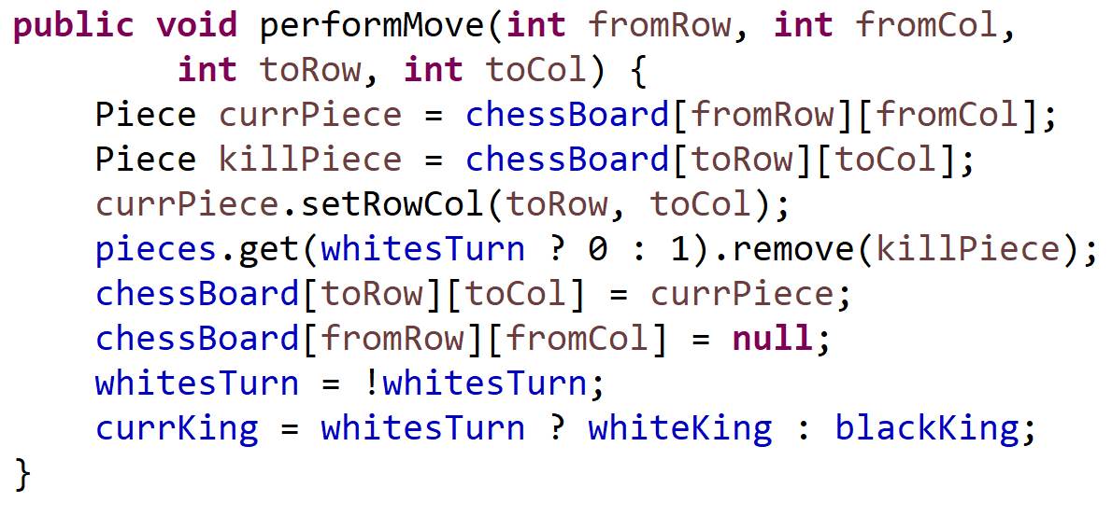
Moving a piece
A few variables must be changed when moving a piece
The moving piece must update it’s internal row and column
We need to move the piece in the 2D array
We must remove the attacked piece from it’s respective ArrayList

Slide 23
Game over
After each move we check if the game is over. Either through a checkmate or a stalemate
There are three basic stalemates
A player cannot make any legal moves
Both players only have a kings left
One player only has a king and eighteen moves have passed
Checkmate has two basic parts to it
Check if the king is in check (can any opposing piece attack it)
If it is, can it make any legal moves to take it out of check (if not, checkmate)

Slide 24
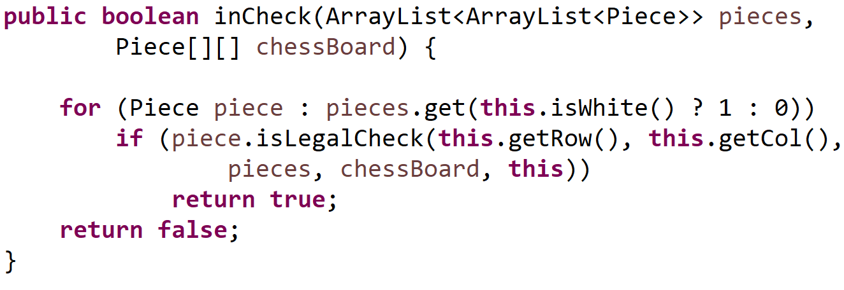
Check for check
Because of our three-way approach to storing the pieces, checking for a check is incredibly easy
Loop over the opposing pieces
Each one tries to kill the king
If it’s able to, check
If not, try the next piece
If all pieces fail, no check

Slide 25
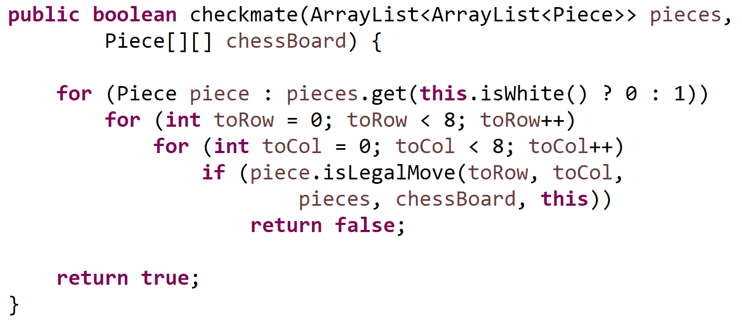
Check for checkmate
Once we’re in check, are we also in checkmate?
No short way to do this
Loop over every piece and attempt to move it all over
Are we still in check?
If not, no checkmate
If yes, try the next piece
Finally, if still yes, checkmate

Slide 26
!!!!!!!!!!!!!!!!!!!!
THE NEXT SLIDES ARE NOT YET DONE
DON’T WORRY
I’LL GET THERE

Slide 27


Slide 28
Stack overflow

Slide 29
Artificial intelligence
True chess AI is impossible

Slide 30
Save game
The ChessBoard implements serializable
Append issue

Slide 31
DISPLAY
ANSI
JANSI
CONTROL CHARS
WINDOWS CMD VS OTHER TERMINALS

Slide 32
TAKEAWAYS
PLANNING
AVOID A LOT OF ERROS IF WE PLANNED
TESTING
TEST MORE
OBJECTIFY!

